Slide 1


SATT LUTECH
FROM UNIVERSITY TO BUSINESS
Naïma LEBAL / Project manager

Slide 4

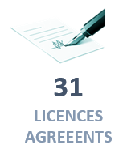
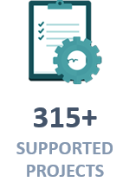
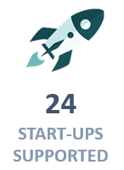
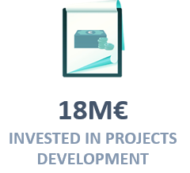
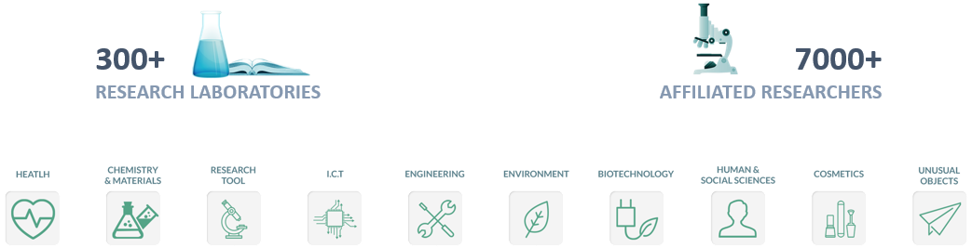
SATT LUTECH AT A GLANCE

Slide 5









LUTECH’S PARTNERS

Slide 7
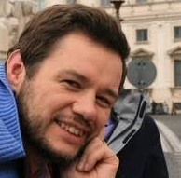
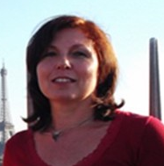
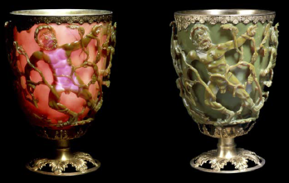
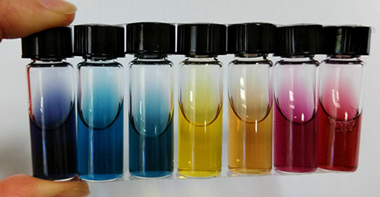


DEEPTECH PROJECTS/ Example 1: BICHROMATICS
Olivier Pluchery
Hynd Remita
The Lycurgus cup
British museum (LONDON)
Two different colors for the same medium following the lighting
Start-up (soon)
Winners of
Incubation (soon)
Patent FR1556942 (2015)/
WO 2017013373 A1 (2017)
Coaching

Slide 8
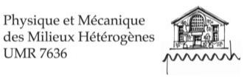
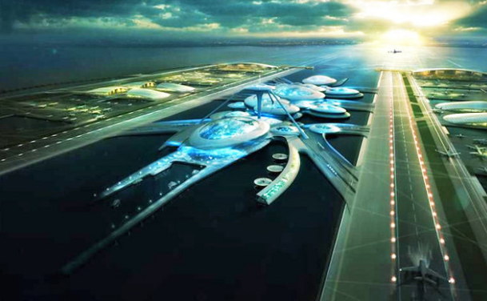
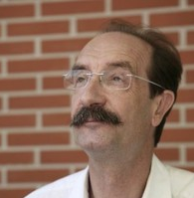

DEEPTECH PROJECTS/ Example 2: WAVES
Maritime platform for wave energy recovery and concentration
Market expertise (during prematuration) to identify the applications of such device and define the valorization strategy
Technological maturation program (intermediate scale prototype in a test tank)
Partnership with
Patent FR 1752718 (2017)
Postdoctoral student

